Slide 1
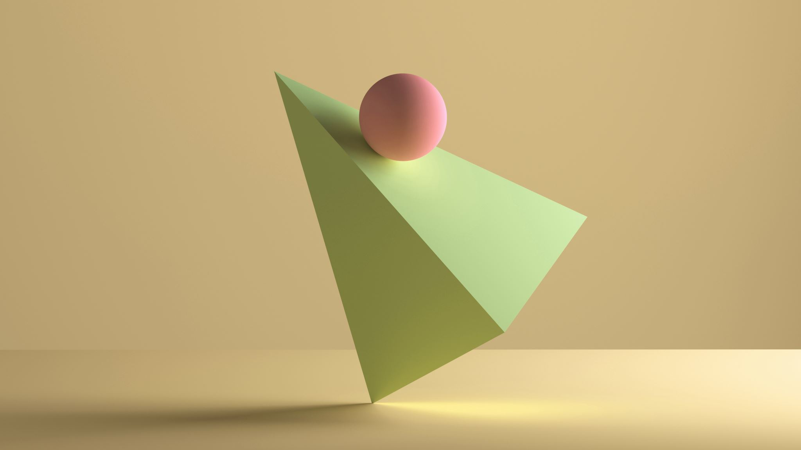
Mathematics in sports

Slide 2
Where we can find the math in sports
we can find it in a lot of sports, and some are: football, basketball, gymnastics, long jump and others
mathematics is in sports betting
in this presentation we will list only a couple of sports because in almost all sports there is mathematics

Slide 3
Football and mathematics
football is one of the most popular sports in the world
dimensions of the football field
attacking tactics
assistance
goals scored
all these elements belong to mathematics

Slide 4
Football terrain dimensions

Slide 5
Basketball and mathematics
terrain dimensions
basket size
throwing angle of the ball
assists in hammering baskets
these are some mathematical elements in basketball

Slide 6
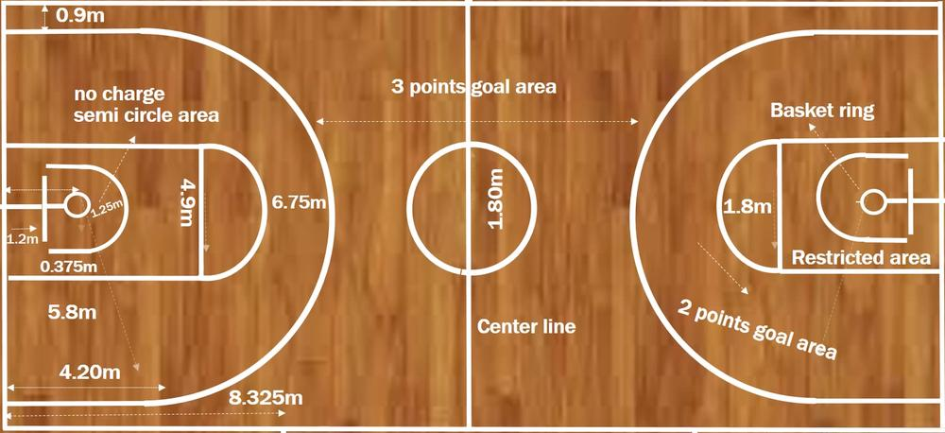
Basketball terrain dimensions

Slide 7
Bowling and mathematics
the size of the ball
path length
weight of the ball
throw angle
cone positions
these are some mathematic al elements

Slide 8
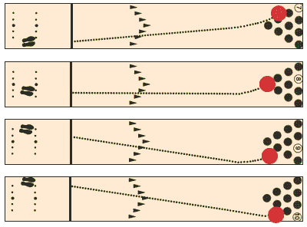
Dimensions of the ball and cones and bowling tactics

Slide 9
Sports betting and mathematics
coefficients
percentages
ratios
these are some mathematical elements

Slide 10
Literature
https://hrcak.srce.hr/file/143607
https://hr.wikipedia.org/wiki/Nogometno_igrali%C5%A1te
https://www.rankonesport.com/content/

Slide 11
MADE BY:
Ema and Ivona, 8th grade students, Elementary school Pušća
MENTORED BY:
Marijana Pili, Math teacher, Elementary School Pušća

Slide 12
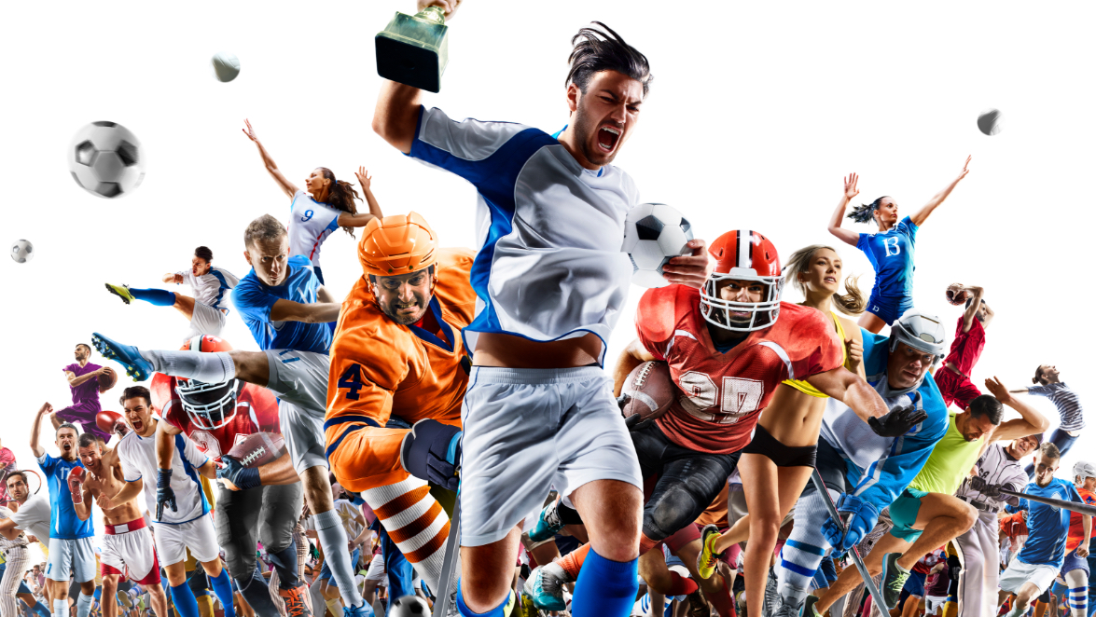
THE END

