Slide 1
Mathematics in fine arts

Slide 2
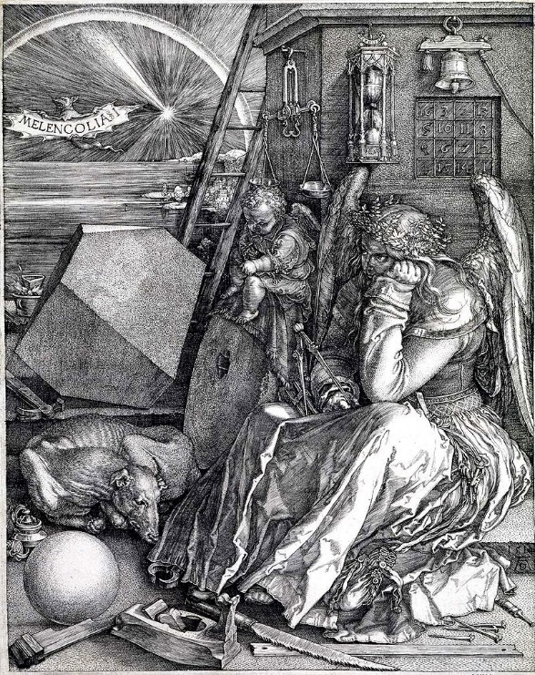
mathematics can be discerned in arts such as music, dance, painting, architecture, sculpture, and textiles
mathematics and art have a long historical relationship
mathematics and art are related in a variety of ways, mathematics has itself been described as an art motivated by beauty

Slide 3
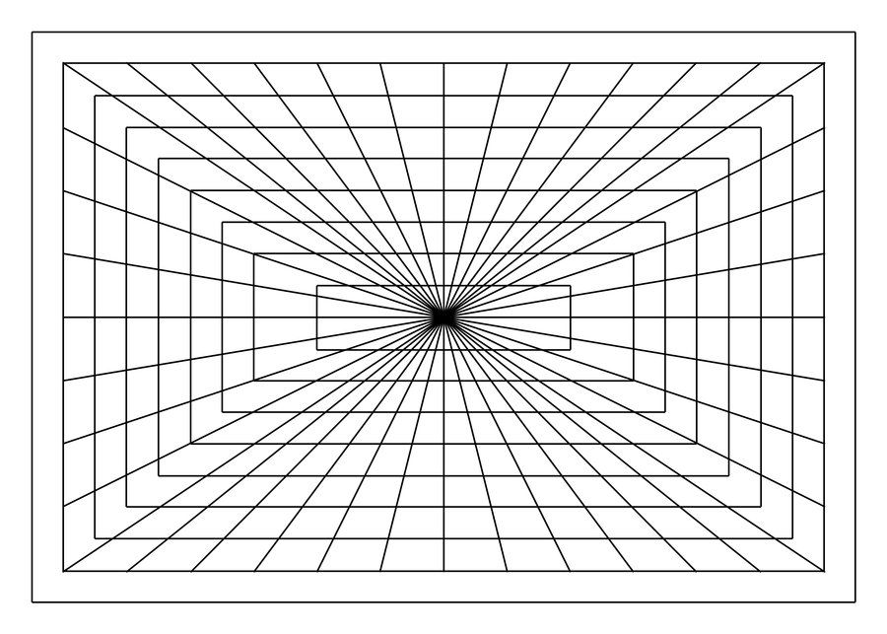
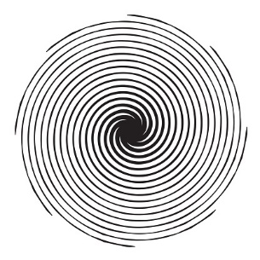
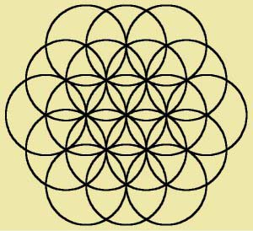
Mathematical patterns that appear in painting :
straight lines
circular lines
circles

Slide 4
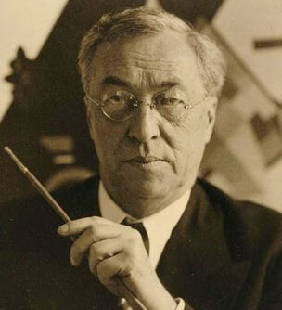
- Vasily Kandinsky is a German painter of Russian descent
- he is one of the most important painters of the 20th century
- born: 16. december 1866., Moscow, Russia
- death: 13. december 1944.
- famous works: Blue Rider; On white II; Composition X
Vasily Kandinsky

Slide 5
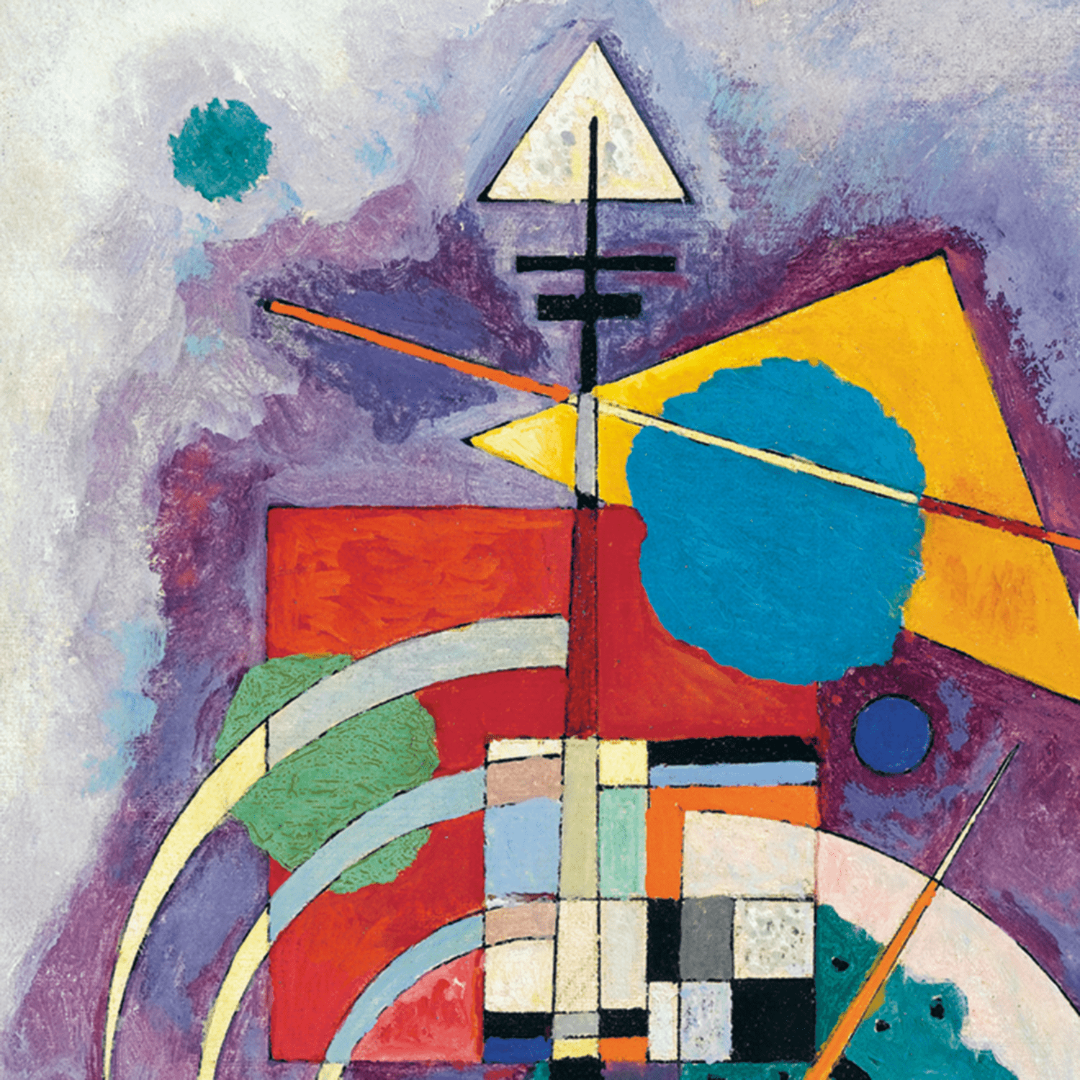
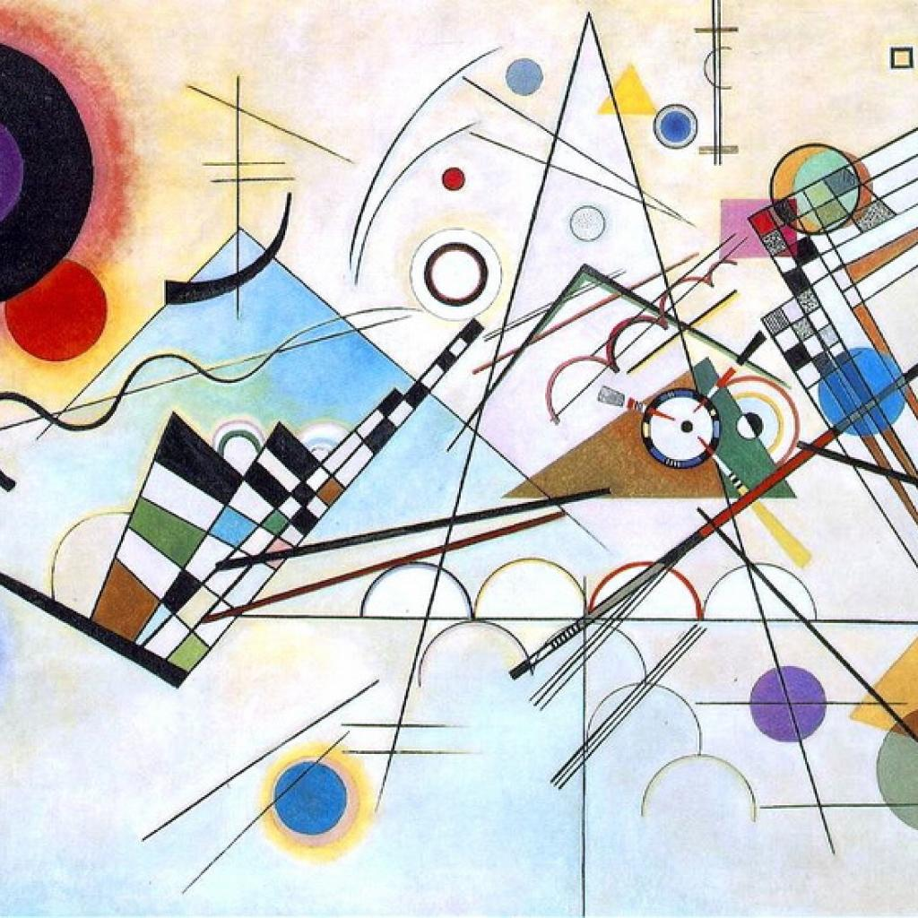
Vasily Kandinsky – paintings

Slide 6
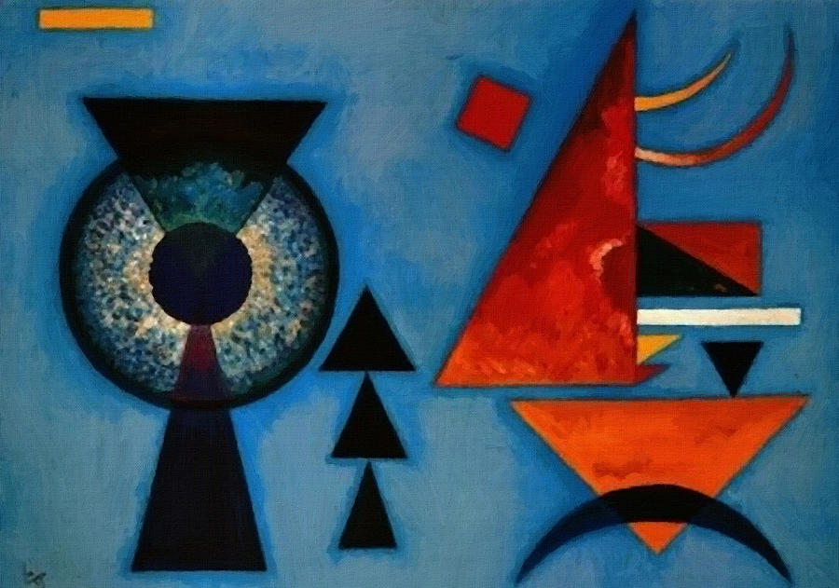
Vasily Kandinsky – paintings

Slide 7
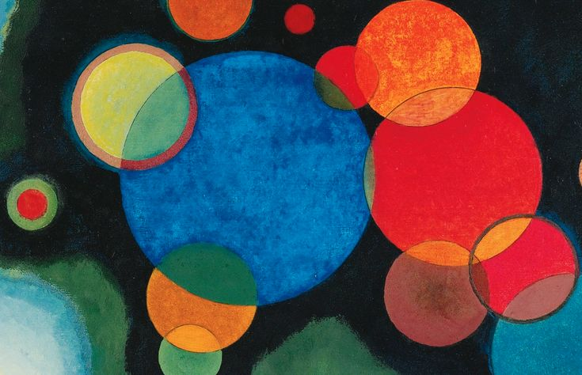
Vasily Kandinsky – paintings

Slide 8
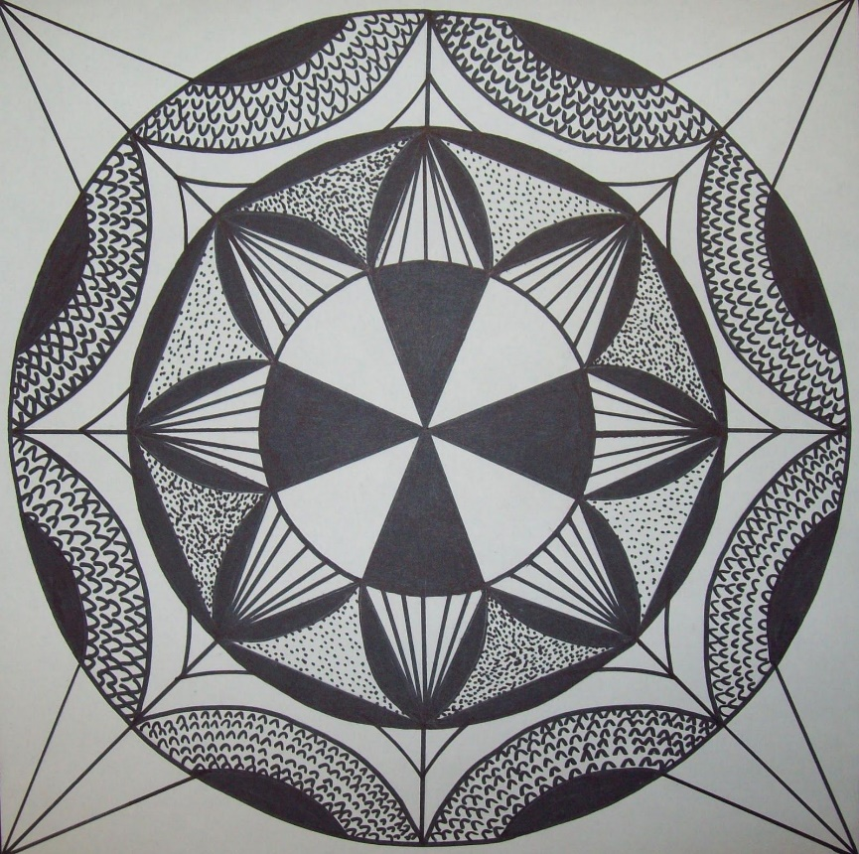
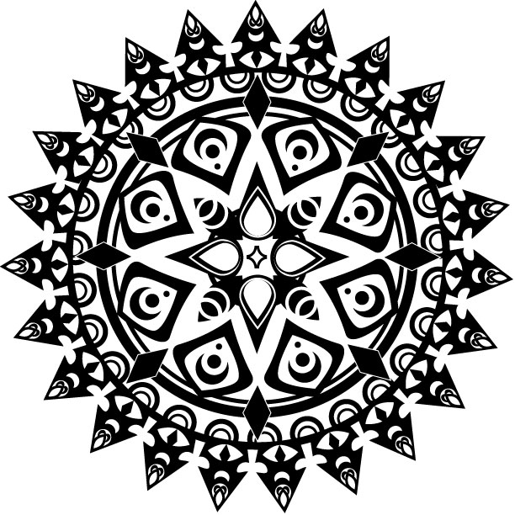
Axial symmetry in art :

Slide 9
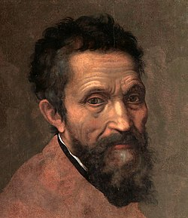
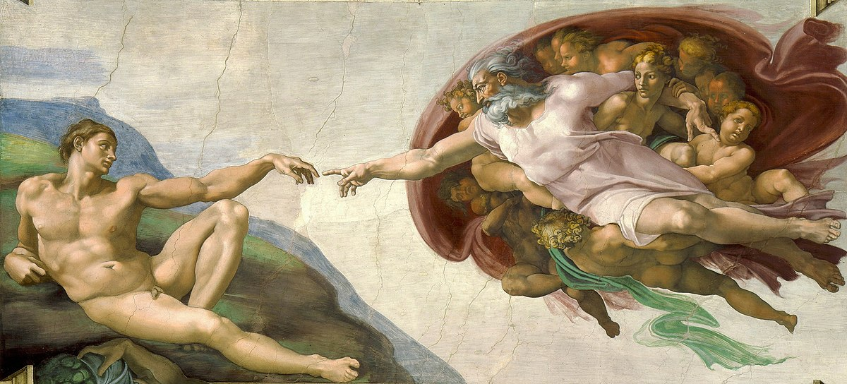
- Michelangelo used mathematics formulas while creating his world-famous painting "The Creation of Adam"
,,a man paints with his brain, not his hands’’
Michelangelo Buonarroti

Slide 10
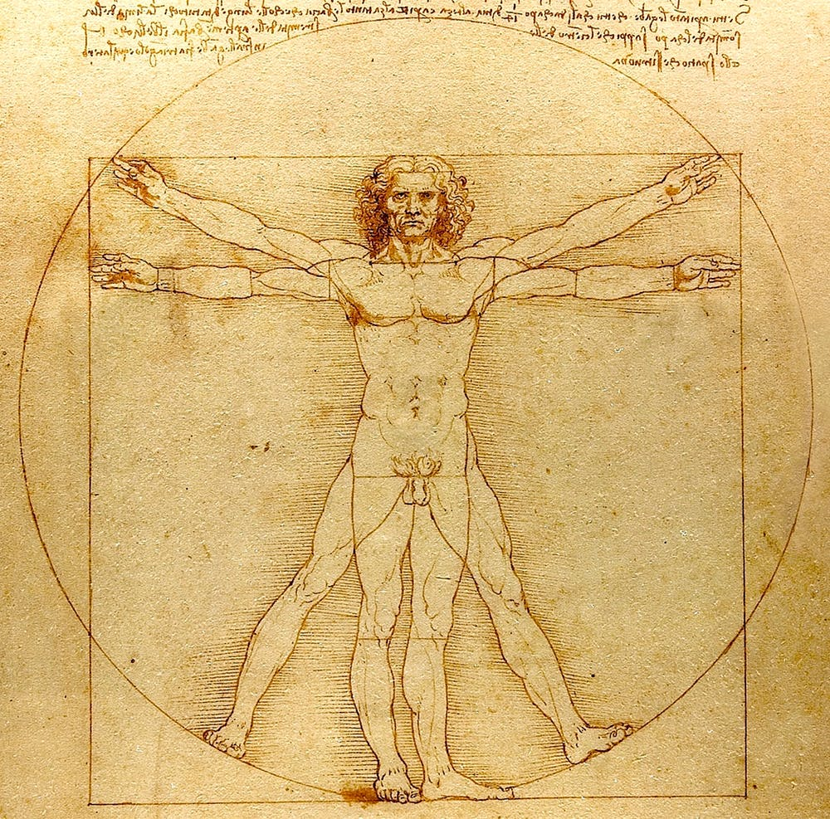
the golden ratio is a mathematical-structural term that is most often associated with art, because it has been used most often in art history. It is a way of dividing some value by a divisor of approximately 1.6. It is also known as the golden mean and the divine
the golden ratio is a compositional law in which the smaller part relates to the larger as the larger part relates to the total
Vitruvian man

Slide 11
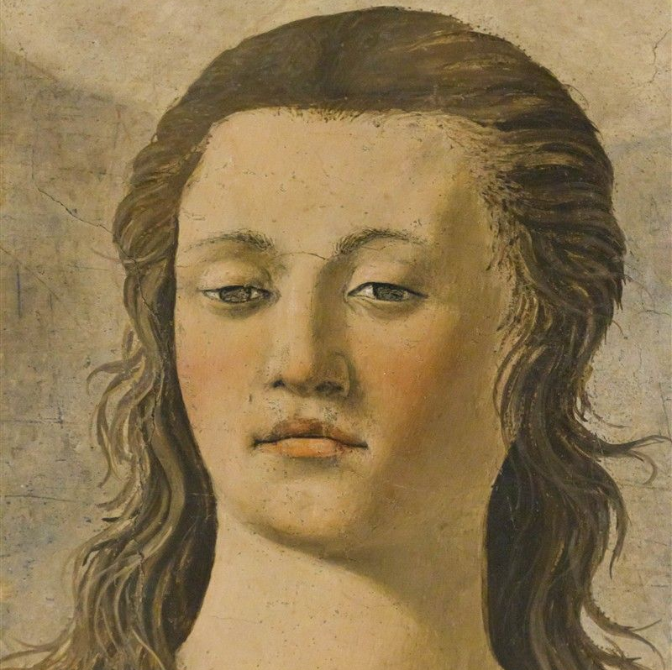
- Piero della Francesca (a famous painter from the 15th century) was one of the greatest authorities for perspective. He had a passion for geometry and planned all his works mathematically down to the last detail. He also published several tracts on mathematics and geometry
Piero della Franesca

Slide 12
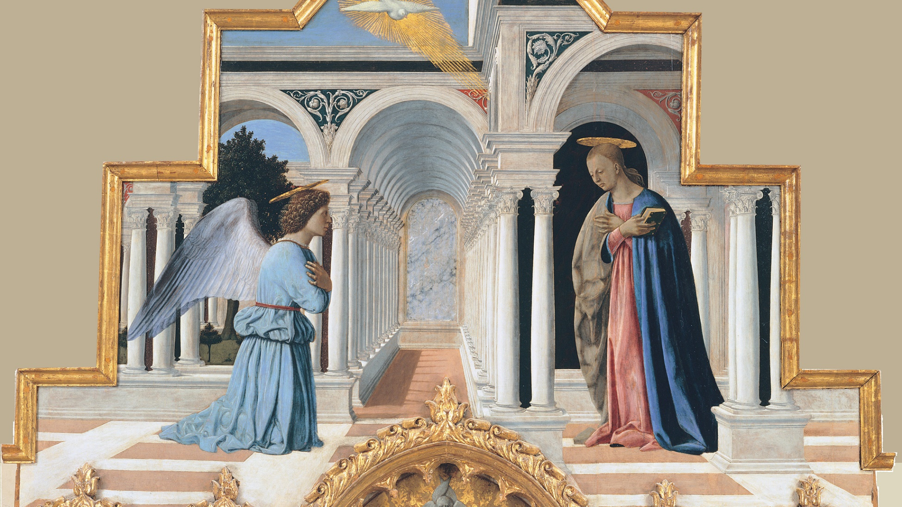
Piero della Francesca – paintings

Slide 13
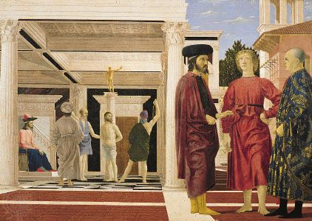
Piero della Francesca – paintings

Slide 14
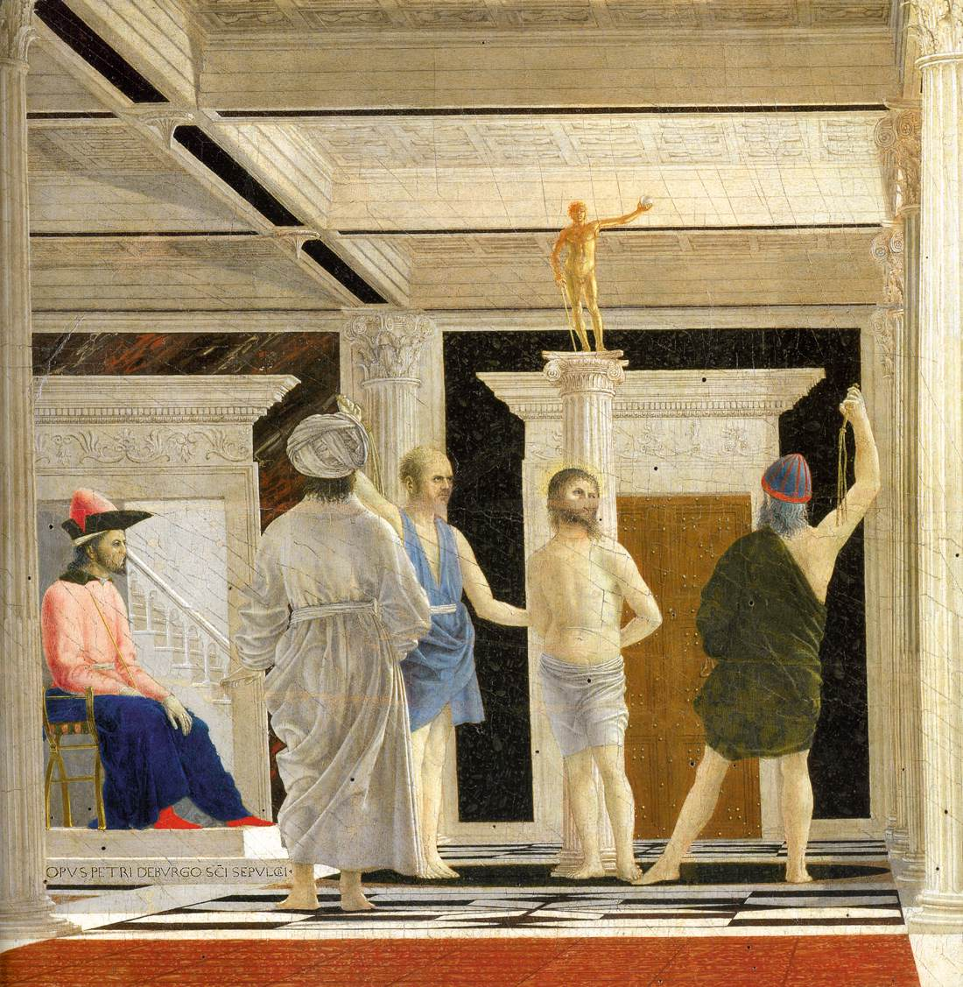
Piero della Francesca – paintings
Piero della Francesca – paintings

Slide 15
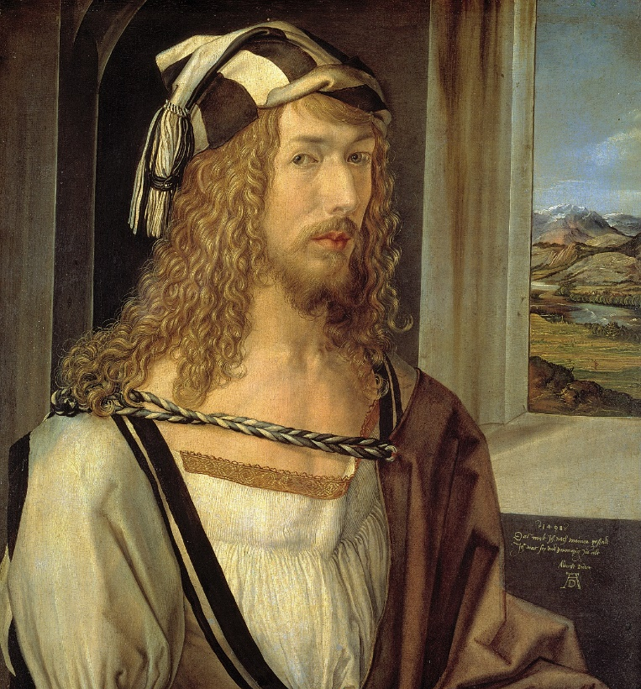
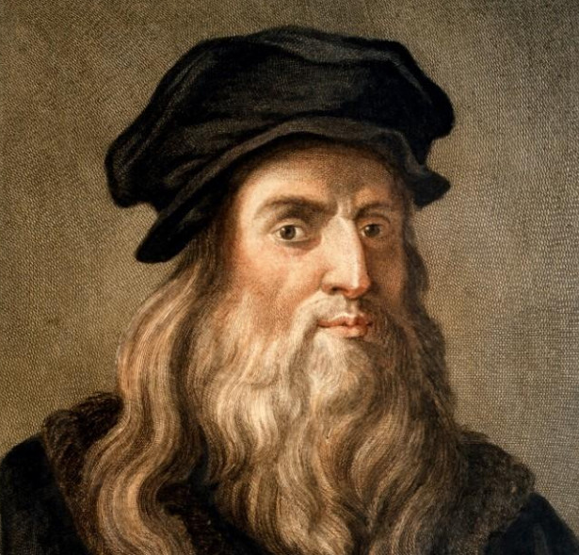
- Leonardo da Vinci and Albrecht Durer (15th and 16th centuries) studied and used knowledge of perspective, human body proportions, optics and color science
Albrecht Dürer
Leonardo da Vinci

Slide 16
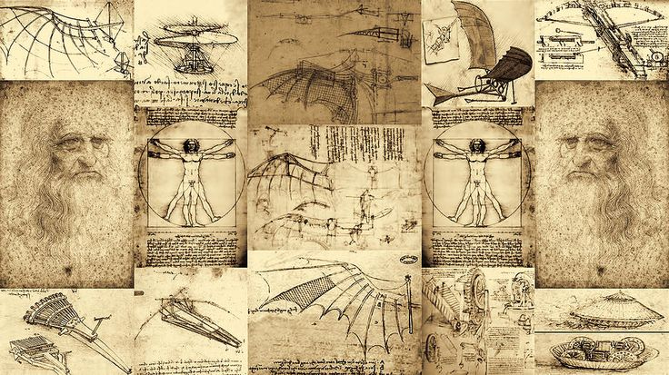
Leonardo da Vinci – sketches

Slide 17
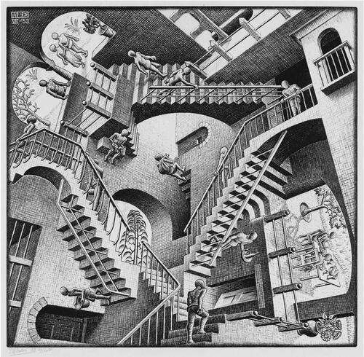
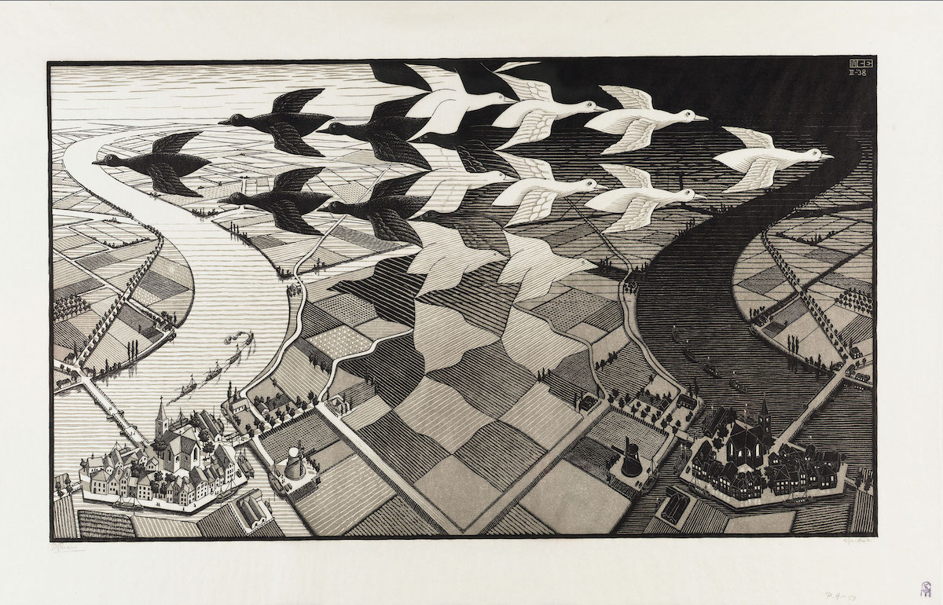
Escher – Dutch graphic artist
- he is better known as M.C.Escher and is known for his, mostly mathematically inspired etchings and woodcuts

Slide 18
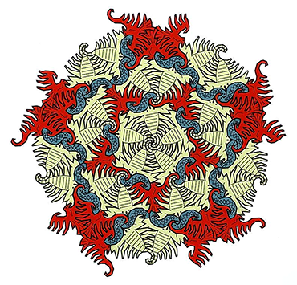
Modern art
modern artists continue to look to math for inspiration
Fathauer created a screen print inspired by his hometown. It uses three shapes — a scorpion, a snake and a bird — to cover a flat surface and the design is a nod to tessellations
they are patterns that use interlocking geometric shapes to “tile,” or fill in, a two-dimensional plane

Slide 19
Literature
https://en.wikipedia.org/wiki/Mathematics_and_art
https://uwaterloo.ca/math/news/top-5-expressions-mathematics-art
https://www.sciencenewsforstudents.org/article/math-is-muse-for-these-artists

Slide 20
The end
Made by : Bruno and Luka, 8.B, Elementary School Pušća
Mentored by: Marijana Pili, Math teacher, Elementary School Pušća

